Slide 1












Airbnb
Case Study
Team 45
Chris Chen
Ziling Chen
Krishna Gupta
Sam MacArthur

Slide 2


Business Understanding
Business Challenges
Aim
Airbnb faces issues with unreasonable pricing, which undermines platform trust and user experience.
Excessively high prices lead to fewer bookings and reduced income for hosts.
Pricing that is too low distorts market signals and prevents hosts from maximizing their earnings.
By analyzing existing data, we can understand the factors that influence pricing, such as location, number of rooms, and ancillary facilities.
Estimate a fair and competitive price for the hosts using data mining methods and multiple modeling techniques.

Slide 3

Research Question Break Down & Solution
How do we determine which factors influence Airbnb pricing?
Linear regression model: incorporating all numerical features and encoded categorical features to develop an initial cognitive framework of price-influencing factors
Lasso: automatically identify truly significant variables through feature selection, eliminating irrelevant items.
Linear Regression with Interaction: explore synergistic effects between different variables.
Research Question
How can Airbnb evaluate factors such as location, room type, and amenities to determine appropriate and competitive prices for properties?
How to predict a reasonable price?
Utilize the model obtained from the first question to provide an expected price for each property listing.
Calculate the gap between the expected price and the actual price.
Categorize these listings and offer pricing recommendations to hosts.
Random Forest: Enhances the prediction accuracy of the model and captures aspects overlooked by linear models.

Slide 4
Data Understanding
Data volume: 73,773
Dimensions: 29 variables, including numerical variables such as various room counts and maximum occupancy, categorical variables like housing type and city, as well as plain text information such as names and descriptions
(Due to the large number of dimensions, they cannot be displayed on a single line here and have been split into two lines.)

Slide 5
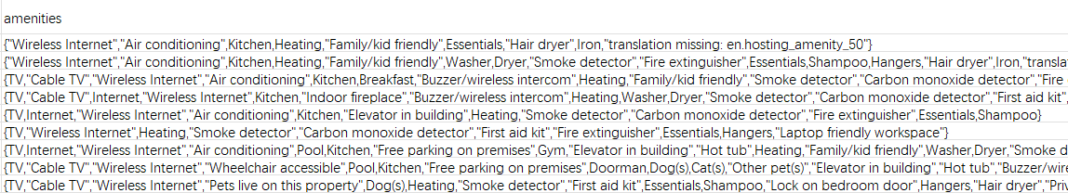
Data Understanding
It is worth noting that the “amenities” field contains a wide range of information related to housing facilities (i.e., the availability of TV or wireless internet). However, all this data is stored as a single string within the same column. The processing of this data will be covered in detail in the ‘Data Cleaning’ section.

Slide 6
Data Cleaning
9 categorical variables, 5 string variables, and 15 numerical variables
The following processing steps were performed:
Remove unnecessary columns: description, bed_type (since 98% of the dataset consists of real beds), host_has_profile_pic, name, neighbourhood, thumbnail_url.
property_type: Since apartments and houses are particularly numerous (approximately 66% apartments and 22% houses), all other property_types were categorized as “other.”
cancellation_policy: all policies (strict, super_strict_30, super_strict_60) are grouped under strict.
host_response_rate: retain only the numerical value.
amenities: since the dataset combines multiple amenities into a single column, clean the data as follows: First, place over 70,000 rows of amenities into a list separated by commas. Iterate through each item, extract all unique amenities, and create a boolean column.After cleaning, 127 boolean columns were generated. To streamline subsequent analysis, only the 28 boolean columns with a total sum exceeding 10,000 were selected.
Encode all categorical variables (room_type, cleaning_fee, city, cancellation_policy, instant_bookable).

Slide 7
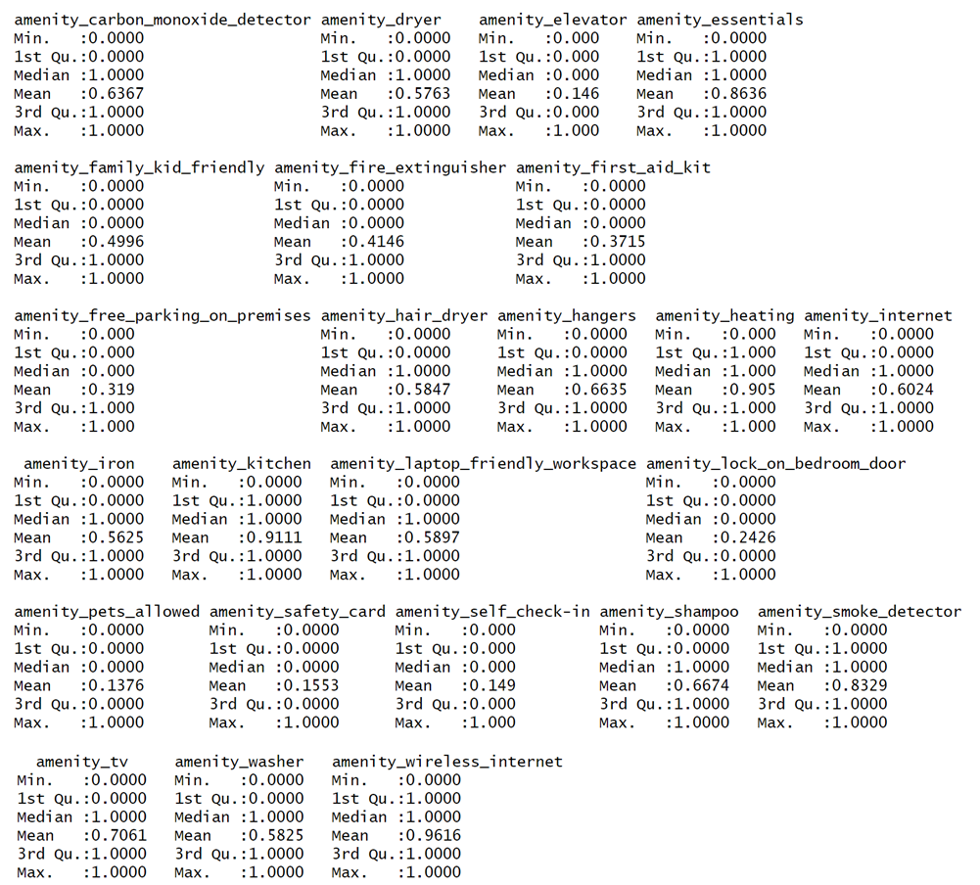
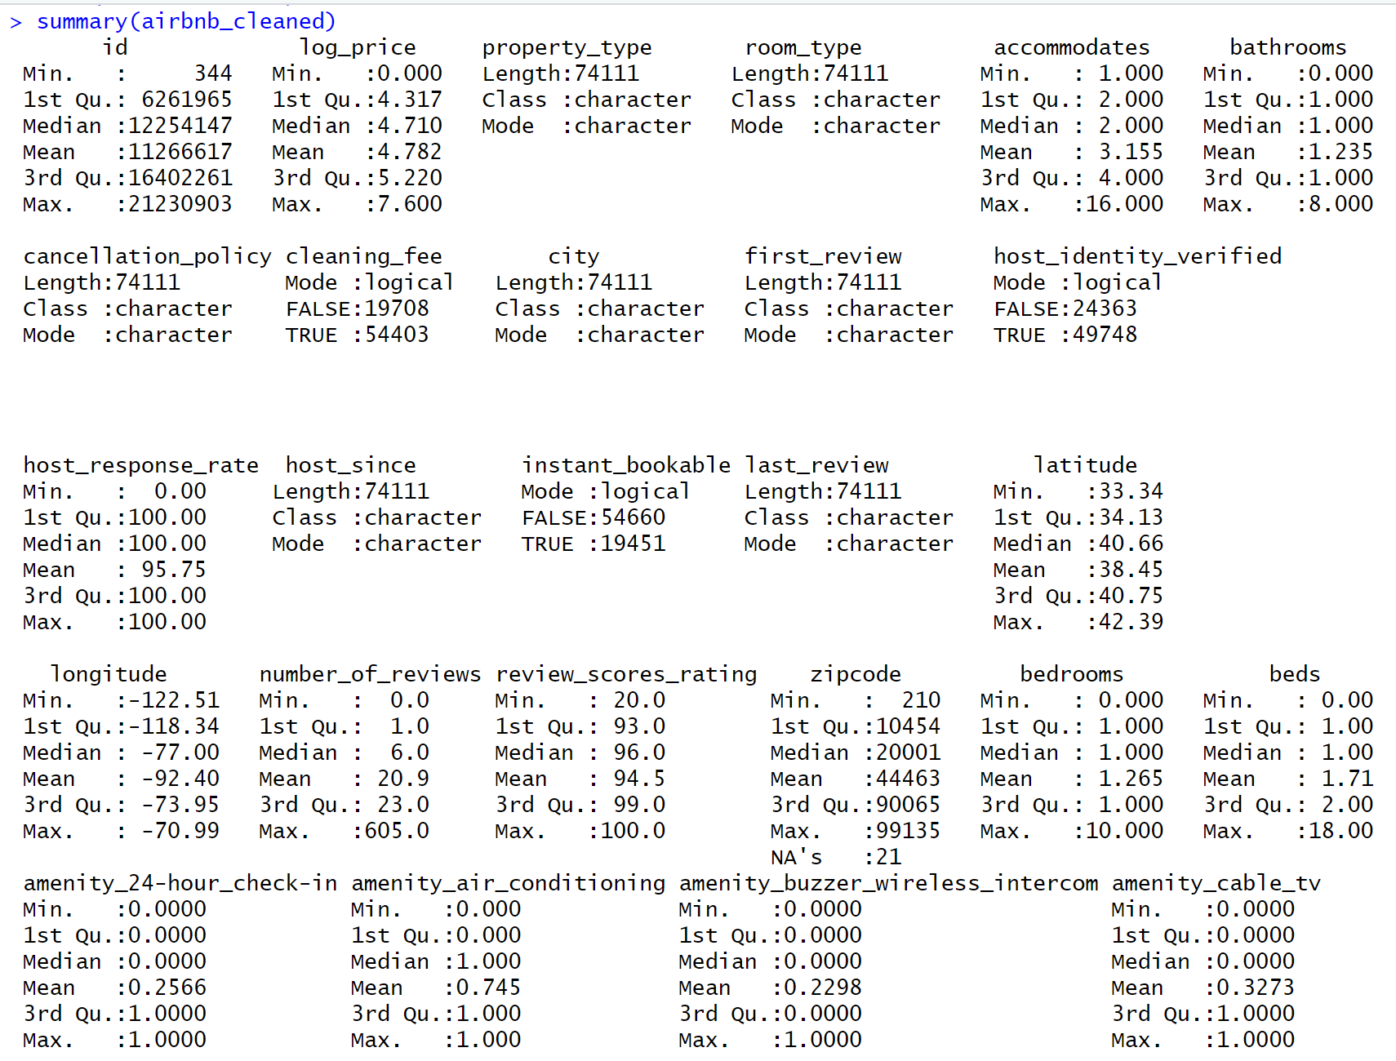
Data Cleaning
The cleaning process resulted in the following dataset. Note: All variables beginning with “amenity” are Boolean variables.

Slide 8
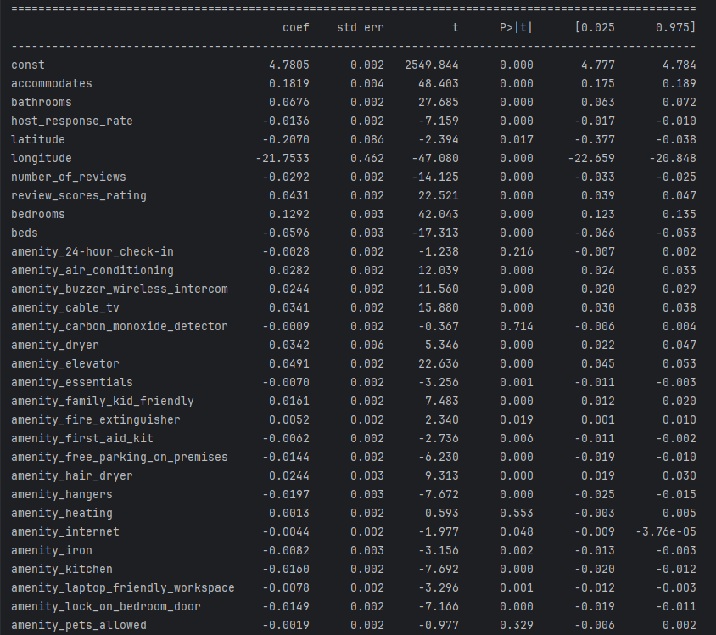
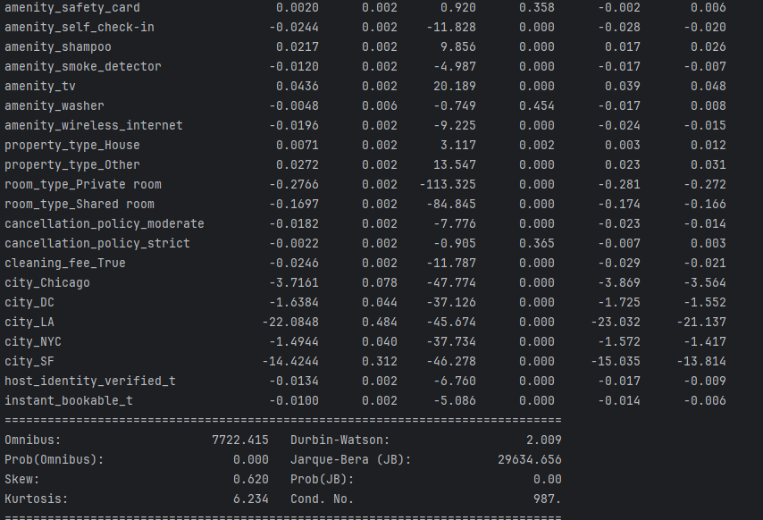
Modeling – Linear Regression

Slide 9
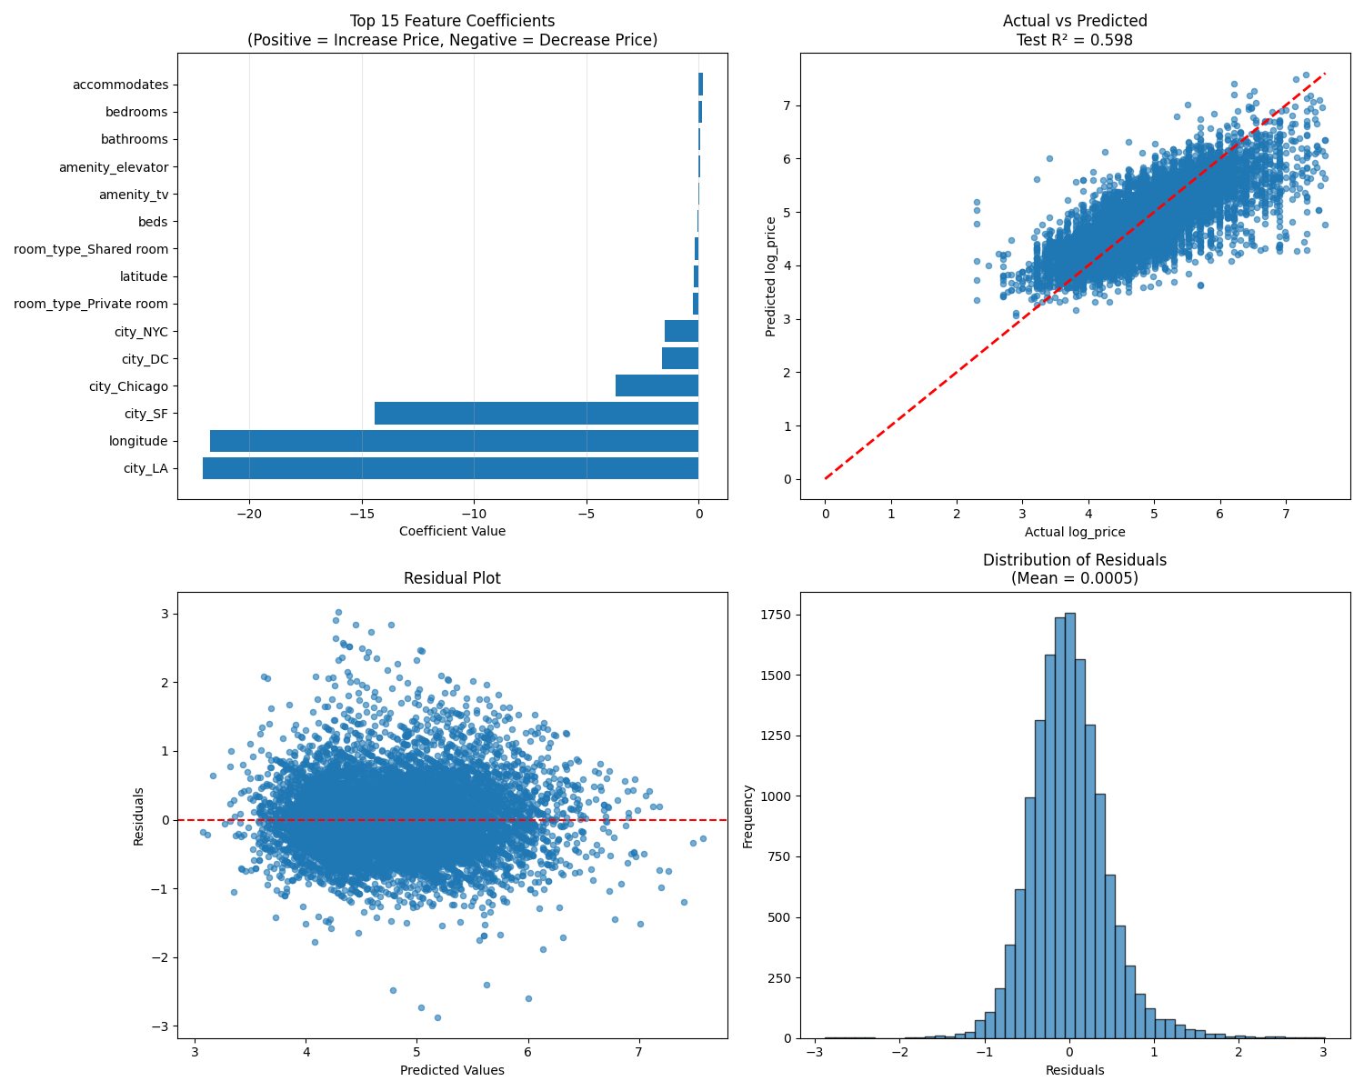
Modeling – Linear Regression
 | Train | Test
RMSE | 0.4563 | 0.4544
R-square | 0.5956 | 0.5981
MAE | 0.3402 | 0.3400
5-fold CV RMSE | 0.4653
51 features related to location, property type, room type, capacity, amenities, host characteristics, and policy
Key Insights:
The number of guests a room can accommodate significantly impacts pricing (accommodates, bedrooms, bathrooms).
Compared to shared rooms, consumers prefer renting private rooms. (room_type_Private room, room_type_Shared room)
Geographic location also significantly impacts rental prices, with western regions generally having lower rates. (latitude, longitude, city_Chicago, city_DC, city_LA, city_NYC, city_SF).
Figure 1
Confirms that residuals were randomly distributed and approximately normal, supporting the model’s assumptions.
While interpretable, this model assumes linearity and independence, which limits its ability to capture complex interactions.

Slide 10
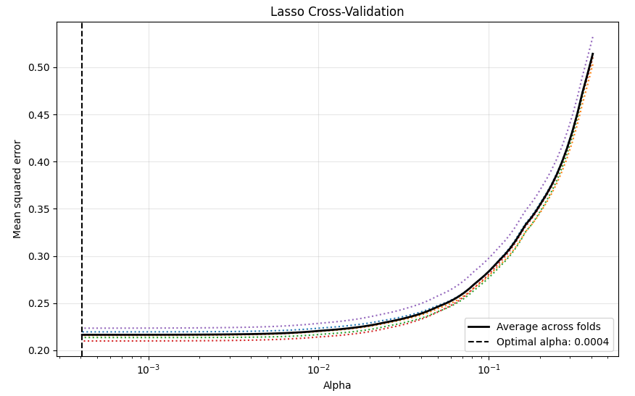
Modeling – Lasso
 | Train | Test
RMSE | 0.4563 | 0.4544
R-square | 0.5956 | 0.5981
MAE | 0.3402 | 0.3400
5-fold CV RMSE | 0.4653
Lasso retained 48 of the 51 predictors, identifying the most influential variables while removing redundant ones.
The removed features: latitude, longitude, cancellation_policy_strict
Figure 2
Figure 2 presents the cross-validation curve used to select the optimal alpha for Lasso regularization. The minimum mean-squared-error occurs near alpha = 0.0004, balancing bias and variance effectively.

Slide 11
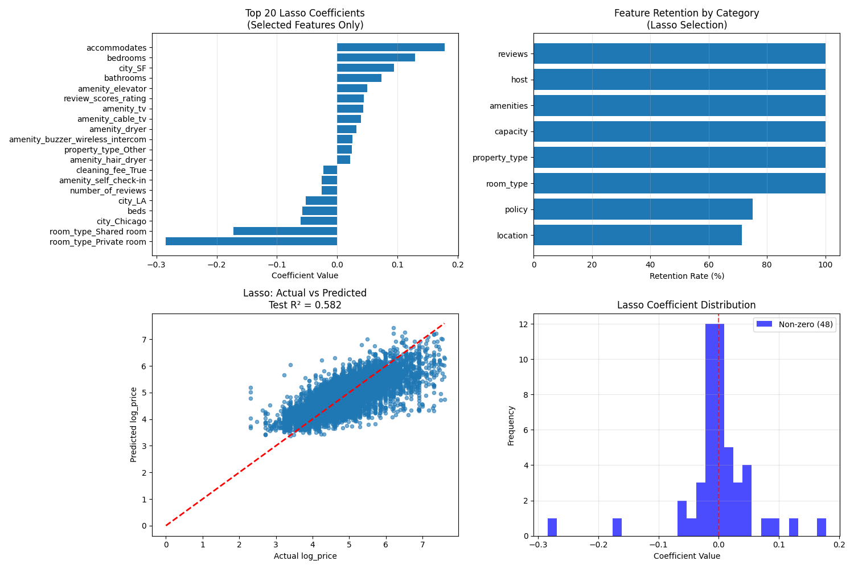
Modeling – Lasso
Key Insights:
Accommodates and bedrooms again have the largest positive impacts, aligned with the result from linear regression
The city still exerts a significant influence on prices, particularly with lower prices observed in West Coast cities. Notably, SF can positively impact prices in Lasso, which contradicts linear regression
The feature-retention chart confirms that nearly all categories retain predictive power.
The lower panels show the predicted versus actual values and coefficient distribution, highlighting that 48 features remain non-zero after penalization, simplifying the model while maintaining accuracy.
Figure 3

Slide 12
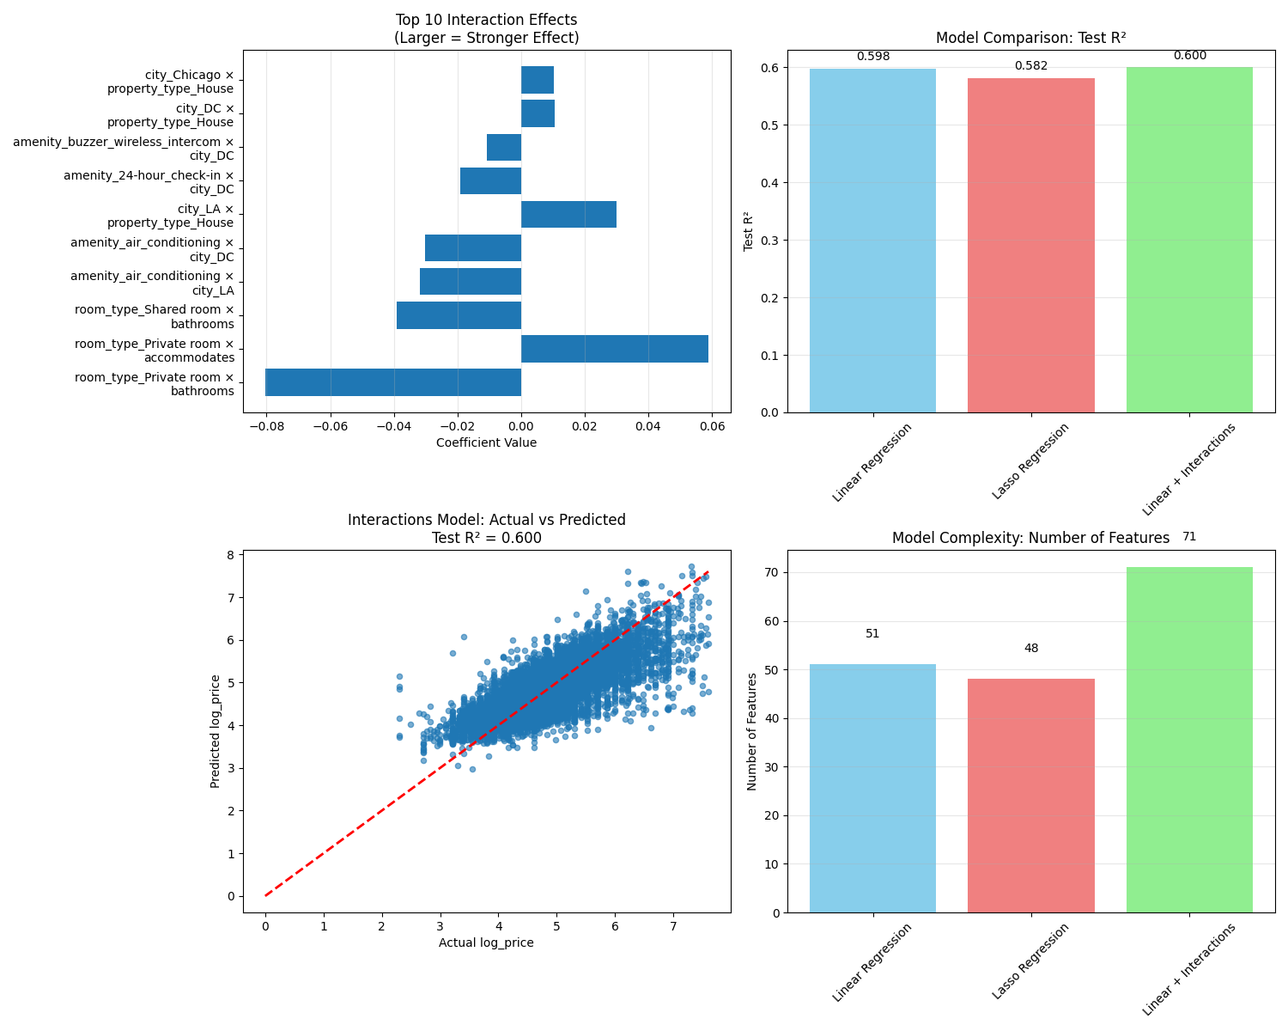
Modeling – Linear Regression with Interaction
 | Train | Test
RMSE | 0.4551 | 0.4531
R-square | 0.5977 | 0.6003
MAE | 0.3410 | 0.3398
5-fold CV RMSE | 0.4559
For private room types, the marginal price increase from adding a bathroom is relatively low, indicating that guests' price expectations for private rooms do not overly depend on hardware configurations, but may place greater emphasis on factors such as occupancy capacity and cost-effectiveness.
In the interaction between cities and amenities, both Los Angeles and Washington, D.C. exhibit negative interaction coefficients with air conditioning. This suggests that in these cities, providing air conditioning is no longer considered a premium feature but rather a “basic standard,” leading to saturated or even negative marginal contributions to price.

Slide 13
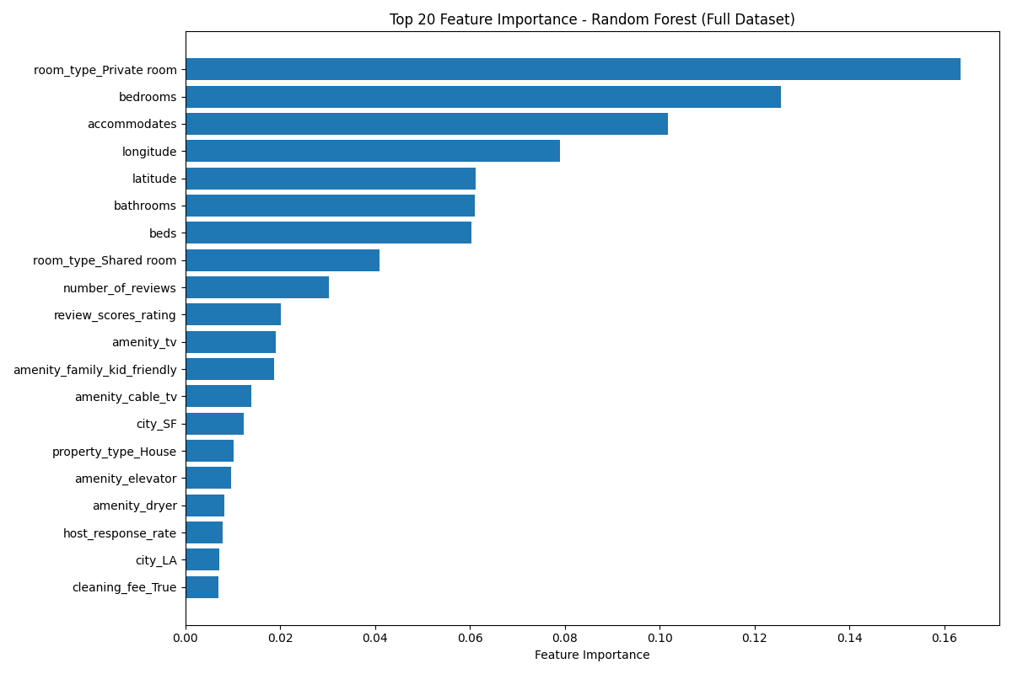
Modeling – Random Forest
 | Train | Test
RMSE | 0.2731 | 0.4007
R-square | 0.8552 | 0.6875
MAE | 0.1979 | 0.2916
5-fold CV RMSE | 0.4024
Compared to three linear models, random forests demonstrate greater interpretability, indicating the presence of substantial nonlinear structures and complex interactions that linear models struggle to fully capture.
The model once again confirms that “room type” and “property capacity” are key determinants of price.
Location also demonstrates significant importance, indicating its impact on pricing.
Amenities such as “TV,” “dryer,” and “elevator” rank within the top 20 factors, further highlighting customers' emphasis on supplementary facilities and their willingness to pay a premium for them.

Slide 14
Modeling – Random Forest
We identified properties priced as low as $10 yet projected to reach $181, indicating extreme undervaluation. The host may intentionally underprice to attract bookings quickly.
We also found cases priced as high as $1,800 with projections as low as $123, signaling significant overvaluation. The host may be overly optimistic about market demand or failing to adjust pricing strategies promptly.
 | Undervalued |  | Overvalued
Count | 1483 |  | 1483
Avg Actual Price | $74.15 |  | $429.17
Avg Predicted Price | $141.37 |  | $184.34
Price Ratio | 0.54 | 2.39
The random forest model successfully improved price prediction accuracy and identified existing pricing imbalances through residual calculations. This model provides Airbnb hosts with reasonable pricing recommendations while also helping Airbnb optimize its platform algorithms, thereby enhancing market efficiency and consumer experience.

Slide 15
Evaluation
Metrics Used:
R² – variation in price explained by model
RMSE & MAE – average prediction error
Performance Summary:
Random Forest: Best overall model
Test R² = 0.6875, RMSE = 0.4007, MAE = 0.2916
5-fold CV RMSE = 0.4024 → consistent generalization
Reduced prediction error by 10–15% vs. linear models
Business Value:
Identifies under/overvalued listings
Enables more equitable, data-driven pricing guidance for hosts
Improves booking rates, revenue, and trust
ROI Potential:
5–10% better pricing precision → similar increase in bookings
Significant revenue impact at Airbnb’s scale

Slide 16
Deployment
Implementation:
Integrate model into Airbnb’s host dashboard
Suggest price ranges based on features, location, and amenities
Update recommendations automatically when listings change
Deployment Plan:
Start as an optional tool for hosts to review prices
Gradually move toward semi-automated updates
Retrain model regularly to maintain accuracy
Key Considerations:
Ensure transparency and fairness in recommendations
Monitor for pricing bias across neighborhoods
Risks & Mitigation:
Biased predictions → apply fairness checks
Model drift → retrain periodically
Host reluctance → maintain user control and clear explanations
Impact:
Improves pricing consistency, trust, and market efficiency

